Slide 1

Agentic AI for Financial News Analysis
Retrieval-Augmented Trading Signal Generation
ModernBERT · MongoDB Atlas Vector Search · Google Gemma 3
FIN-5729 AI Trends in Finance · A2 Team Project · Summer Two 2026
Notes:
Title slide. Introduce team and the one-line premise: market-moving information appears in news before it appears in structured data, and we built an agent that reads it.
1

Slide 2
Audience and Assumptions
Who this is for
1
Junior equity research analysts and their team leads at a mid-size asset manager. Secondary audience: the fintech product manager who would own this internally.
What we assume
2
Analysts cover 30+ tickers each. News volume exceeds what any individual can read daily. The firm already licenses a news feed and can host a vector database.
What we are NOT claiming
3
This is a research triage tool, not an execution system. No capital is allocated on its output. Signals are educational and require analyst review before any decision.
Notes:
State this explicitly at the top of the video: the assignment requires naming audience and assumptions before anything else. The third card matters most for grading - it shows we understand the limits of what we built.
2

Slide 3
The Problem: Signal Lives in Unstructured Data
What analysts use today
Where signal appears first
  Stock prices and returns
  Financial statements
  Risk and factor metrics
  Historical performance
  Breaking financial news
  Earnings announcements
  Press releases and filings
  Analyst commentary
Structured, clean, and already priced in by the time it reaches a screen.
Unstructured, high volume, and impossible to monitor manually at scale.
Business question: How can we automatically retrieve and analyse investment-relevant information from large volumes of financial news?
Notes:
Frame the cost side out loud: an analyst covering 30 tickers cannot read every headline. The bottleneck is triage, not judgement.
3

Slide 4
From Manual Research to an Agentic Workflow
MANUAL PROCESS · analyst-hours per ticker
News search
>
Article review
>
Impact analysis
>
Investment decision
AGENTIC PROCESS · seconds per ticker, human reviews the output
Ticker input
>
News retrieval
>
Vector search
>
LLM analysis
>
Signal output
The agent chains retrieval, semantic search, and generation without step-by-step human prompting. The analyst moves from reading everything to reviewing a ranked, evidence-backed shortlist.
Notes:
This is the slide that earns the agentic points. Emphasise multi-step autonomy: one input triggers five chained operations across three systems.
4

Slide 5
01
Model Selection
Why ModernBERT for retrieval and Gemma 3 for generation
Notes:
Short transition slide. Keep it to ten seconds.
5

Slide 6
Two Models, Two Distinct Jobs
E
ModernBERT
G
Gemma 3 1B Instruct
Embedding generation · 768 dimensions
Reasoning and signal generation
  Converts each news article into a dense vector so semantically similar stories cluster together
  Longer context window than the original BERT, which matters for full news articles rather than headlines
  Retrieval quality is what determines whether the LLM sees the right evidence at all
  Instruction-tuned, so it follows a structured output format reliably without fine-tuning
  At 1B parameters it runs on a single free-tier T4 GPU, which matters for reproducibility
  Produces a signal plus the positive and negative factors behind it, not just a label
Why not a finance-specific model such as FinBERT?
FinBERT classifies sentiment as positive, negative, or neutral. It cannot generate reasoning, cannot cite the article it drew on, and cannot be told to output a structured signal. We needed retrieval plus generation, so we split the task across a specialist embedder and a general instruction-tuned LLM.
Notes:
The rubric gives 20 points for model rationale. "Not covered in class" is not a rationale - the FinBERT comparison is what makes this defensible. Say it out loud in the video.
6

Slide 7
02
System Architecture
A RAG pipeline from news feed to trading signal
Notes:
Transition.
7

Slide 8
RAG Pipeline Architecture
01
>
02
>
03
>
04
Yahoo Finance
Document Processing
ModernBERT
MongoDB Atlas
News retrieval by ticker
Clean, chunk, structure
Generate 768-dim embeddings
Vector store and index
05
>
06
>
07
>
08
Vector Search
Context Assembly
Gemma 3
Trading Signal
Cosine similarity top-k
Build the LLM prompt
Analyse and reason
BUY / HOLD / SELL
Steps 1 to 5 run without human input. The analyst enters a ticker and reviews the output at step 8.
Stack: Python · Google Colab (T4 GPU) · Hugging Face Transformers · MongoDB Atlas Vector Search · Gradio
Notes:
Walk the numbers in order. Pause on step 4 and 5 - the vector index is the piece most people have not built before, and it is where the retrieval quality is decided.
8

Slide 9
Dataset Overview
10
50
768
5
Tickers analysed
News articles embedded
Embedding dimensions
Days of news coverage
Source and collection
Known data constraints
  Yahoo Finance news endpoint, queried per ticker at run time
  Each article stored with title, summary, publisher, and timestamp
  Embeddings written to MongoDB Atlas collection FinancialNews
  Vector index: cosine similarity, 768 dimensions
  Coverage is uneven across tickers - large caps return far more articles than mid caps
  Yahoo Finance returns recent items only, so there is no long history to backtest against
  Headlines and summaries only, not full article bodies
Notes:
REPLACE the bracketed placeholders with your real batch numbers before recording. Naming the constraints here rather than hiding them is what separates a 15 from a 20 on analytical quality.
9

Slide 10
03
Results and Insights
What the agent produced across a batch of tickers
Notes:
Transition.
10

Slide 11
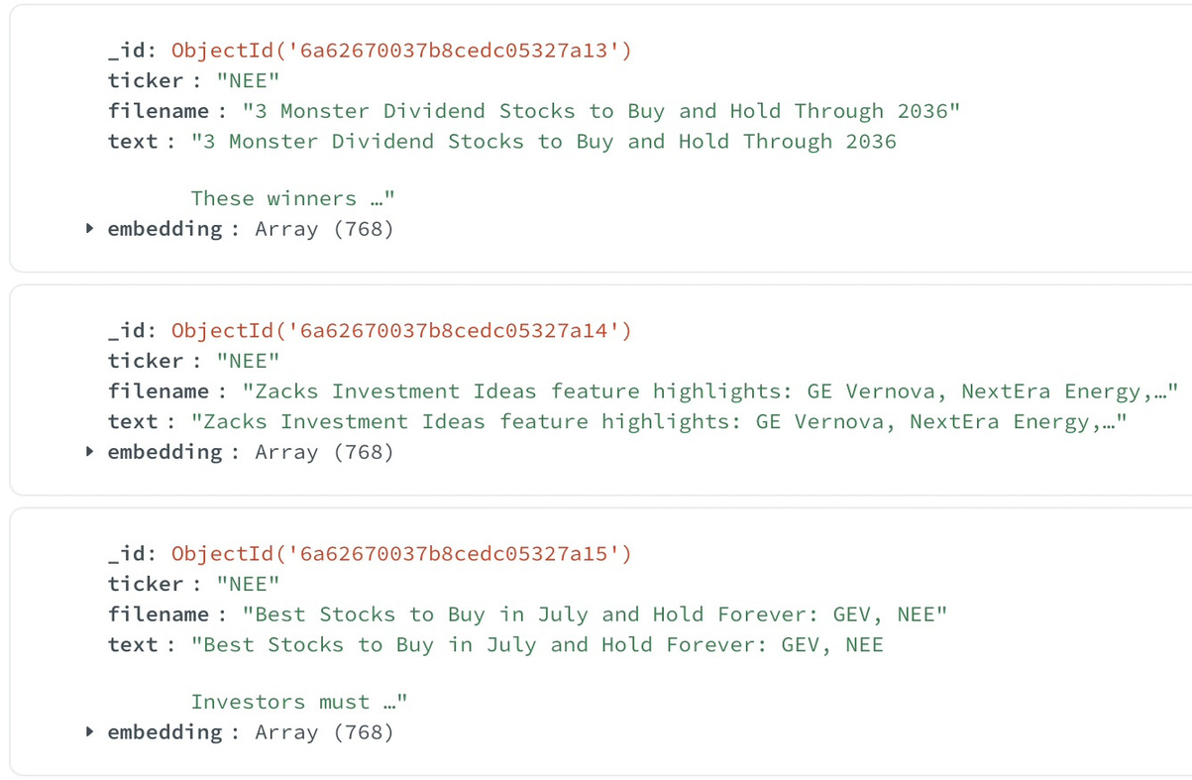
Retrieval Coverage: Batch Results
The NEE case
  Querying NEE retrieves current news and produces HOLD at LOW confidence.
  LOW confidence reflects mixed evidence in the retrieved articles the model hedges rather than forcing a strong call.
  Deployment implication: an explicit "insufficient evidence" fallback remains for tickers where the feed is thin.
Notes:
This slide is the differentiator. Most teams will only demo successful runs. Showing a real failure mode and reasoning about what it means for deployment is what strong analytical quality looks like.
12

Slide 12
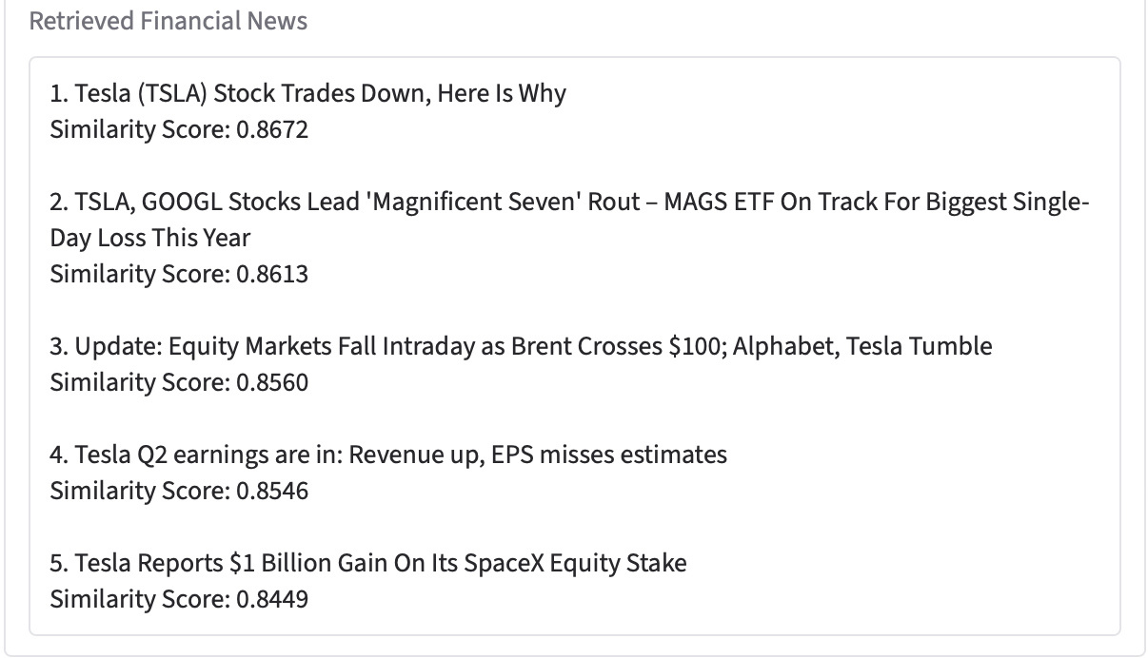
The NEE case
Retrieval Coverage: Batch Results cont.
Notes:
This slide is the differentiator. Most teams will only demo successful runs. Showing a real failure mode and reasoning about what it means for deployment is what strong analytical quality looks like.
12

Slide 13
Output View Dashboard Example
INPUT
SIGNAL
LATENCY
TSLA
SELL
5 seconds
Single ticker, no other input
Confidence: LOW
End to end, on a T4 GPU
Positive factors cited
Negative factors cited
  The company’s revenue growth is positive, indicating a potential for future earnings increases. The $1 billion gain on its SpaceX stake suggests a strategic investment that could benefit the company long-term.
  The reported earnings miss estimates and the negative free cash flow raise concerns about the company’s financial health. The reliance on AI and robotics projects introduces uncertainty.
Notes:
Key point for the video: the model does not just emit a label, it names the evidence on both sides. That is what makes the output auditable by an analyst, which is the whole basis for trusting it.
13

Slide 14
Where the Business Value Sits
1
Triage, not replacement
2
Auditable output
An analyst covering 30 tickers reviews a ranked shortlist instead of an unfiltered news feed. The judgement stays human; the reading volume drops.
Every signal names the positive and negative factors behind it, so a reviewer can check the reasoning rather than trusting a black-box score.
3
Consistent coverage
4
Cheap to run
The agent applies the same process to every ticker at every run. Manual coverage is uneven and depends on who is on desk that day.
A 1B-parameter model on a single T4 GPU. No fine-tuning, no dedicated inference cluster, no per-seat vendor licence.
Notes:
Do not overclaim here. The honest value is triage and consistency, not alpha generation. Graders reward a defensible claim over an inflated one.
14

Slide 15
Limitations and Risks
No backtest
Retrieval gaps
Hallucination risk
We have not validated signals against realised returns. Accuracy is unmeasured, so the output cannot support a capital decision.
Coverage depends entirely on the news feed. Thin coverage produces no signal, as the NEE run showed.
An LLM can assert a factor the retrieved articles do not support. Grounding reduces this; it does not eliminate it.
Recency bias
No position context
Regulatory exposure
The feed returns recent news only, so the agent has no memory of how similar news resolved historically.
The agent does not know the portfolio, cost basis, risk limits, or mandate. A signal without that context is incomplete.
Automated investment output touches suitability and record-keeping obligations. Any production deployment needs compliance review first.
This is a decision-support prototype for research triage. It is not an execution system and no capital should be allocated on its output.
Notes:
The assignment explicitly requires a limitations and risks discussion in the video. Spend at least a full minute here. Naming the regulatory angle signals you thought about deployment, not just the demo.
15

Slide 16
Conclusion
1
What we built
An agentic RAG pipeline that takes a ticker, retrieves financial news, embeds it with ModernBERT, searches a MongoDB Atlas vector index, and generates an evidence-backed trading signal with Gemma 3.
2
What we found
The agent produces auditable, consistently formatted output in seconds. Signals skew heavily to HOLD, and retrieval coverage - not model quality - is the binding constraint on usefulness.
3
What it is good for
Research triage. It narrows an analyst's reading list and shows its reasoning. It does not replace judgement, and without a backtest it cannot support a capital decision.
4
What we would do next
Backtest signals against realised returns, widen the news sources beyond a single feed, and add an explicit insufficient-evidence state instead of forcing a signal.
Notes:
Close on point 3. The strongest ending is an honest scope statement, not a claim that the system beats the market.
16

