Slide 1

Capitalizing on the AI Transition: The Efficiency Swap at JP Morgan Chase
Pricing energy efficiency into derivative contracts for the U.S. Data Center market
Notes:
1

Slide 2

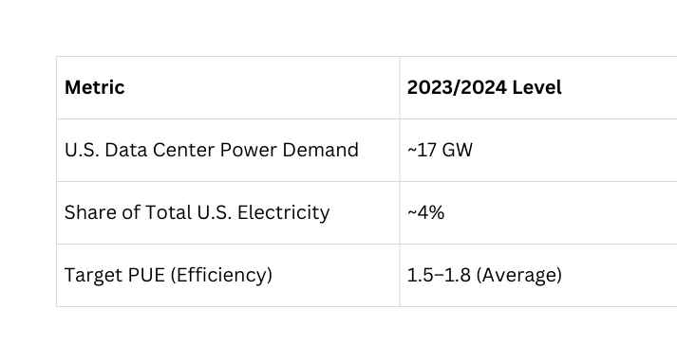
STAKEHOLDER PRESSURE
The Convergence: Institutional Investors, SEC Rules, and Data Center Capital
Institutional Investor Demands
U.S. institutional giants like BlackRock and State Street demand "Transition Resilience" from their technology holdings. The SEC's climate disclosure rules have made energy efficiency a mandatory reporting metric.
Middle-market data center developers face a critical challenge: they need massive capital to build AI infrastructure, but must also prove to American investors that their assets won't be stranded by rising energy costs or future carbon taxes. The Efficiency Swap bridges this gap.

Slide 3
The Efficiency Swap:
Product Architecture
Structure
Step-Down Incentive
Step-Up Penalty
Sustainability-Linked Interest Rate Swap with an Environmental Overlay. A 'Step-Up/Step-Down' pricing mechanism tied to Power Usage Effectiveness (PUE)—the critical KPI for data center efficiency.
Developers achieving PUE of 1.2 or lower receive a 10 basis point reduction in the interest rate spread, rewarding operational efficiency with lower cost of capital.
Failure to meet PUE targets triggers a step-up penalty, creating financial consequences for missed efficiency commitments.
The Efficiency Swap transforms abstract sustainability goals into concrete financial obligations, aligning data center performance with shareholder value creation.

Slide 4




JPMC's Proprietary Framework: Carbon Compass® for Data Centers
Data Centers
Sector-Specific Data Rigor
JPMC's Carbon Compass® provides hard, sector-specific data on energy intensity and carbon footprints. By applying this framework to the U.S. data center sector, we deliver scientific and financial rigor that American auditors and regulators trust. This is the 'Gold Standard' for U.S. capital markets, ensuring every basis point of discount is backed by verifiable data.
AI Infrastructure
Cooling Systems
Power Efficiency

Slide 5
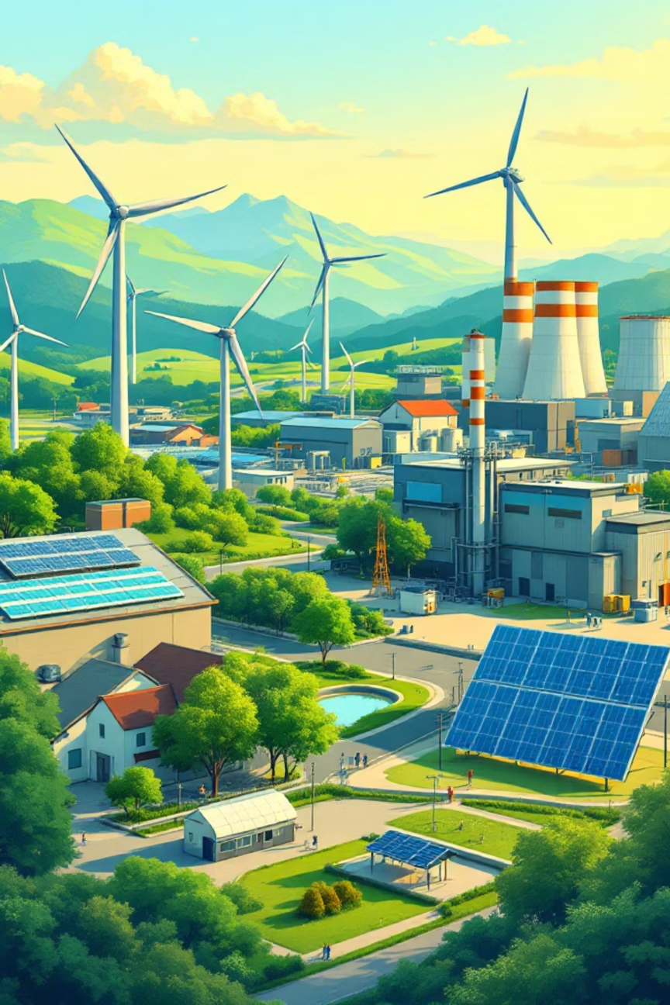
TRANSITION RISK
Addressing Transition Risk: From Energy Volatility to Resilience
Why Energy Efficiency Matters for Data Center Valuations
In the U.S., energy is a material and volatile cost driver for data centers. By incentivizing efficiency through the Efficiency Swap, we ensure our clients are more profitable and statistically less likely to default. For American investors, this isn't a 'concessionary' return—it's Risk-Adjusted Alpha. These products signal which companies are prepared for a low-carbon regulatory environment. In a crowded market, an SLD distinguishes a resilient operator from one exposed to stranded asset risk.

Slide 6
The Financial Logic: Why Lower Rates Protect JPMC's Balance Sheet
$10B
Fiduciary Excellence Through Risk Adjustment
There is a common misconception that lower rates for efficient projects hurt the bank's bottom line. In reality, it's Fiduciary Excellence. A 'green' data center is a more resilient, future-proof asset. By offering a 10-basis-point discount, JPMC buys insurance against asset devaluation.
Estimated market opportunity in U.S. data center financing through 2030
In the U.S. market, a 'Brown Discount' is already emerging—assets that cannot prove energy efficiency are being devalued by secondary markets. Our SLD protects JPMC's balance sheet from this systemic risk.

Slide 7
Guarding Against Greenwashing: Verification Standards
01
02
Third-Party Verification
Standardized Metrics
Mandatory 'Big Four' auditors (Deloitte, PwC, EY, KPMG) verify all PUE and carbon intensity data before any rate adjustment occurs.
PUE (Power Usage Effectiveness) is the industry-standard KPI for data center efficiency, eliminating inconsistent self-reporting and ensuring comparability.
03
04
Legal Certainty
Regulatory Alignment
Clear contractual language defines PUE thresholds (1.2 target), calculation methodologies, and dispute resolution mechanisms for all Efficiency Swaps.
KPIs structured to anticipate SEC climate disclosure rules and potential federal carbon pricing mechanisms affecting data center operations.
Notes:
7

Slide 8

Market Leadership: Setting the Wall Street Standard for Data Centers
$2.5 Trillion Sustainable Development Commitment by 2030
JPMC's ambitious sustainability target positions the Efficiency Swap as the "connective tissue" ensuring capital deployment to data centers actually reduces energy intensity rather than serving as window dressing. By standardizing these swaps, JPMC sets a benchmark that other major U.S. players—from BofA to Citi—will be forced to adopt.
We are moving toward a future where ESG isn't a separate department, but a core component of how risk is priced on Wall Street.
Competitive Advantage: Early-mover status in data center SLD structuring provides JPMC with proprietary data on decarbonization costs across the AI infrastructure sector.
Notes:
8

Slide 9




STRATEGIC RECOMMENDATION
Next Frontier: AI Alley
Current State
Opportunity
Implementation
Efficiency Swaps focus on PUE and carbon intensity metrics
Launch pilot program in 'AI Alley' (Northern Virginia)—the global heart of data center growth
Create scalable blueprint for global rollout and standardization
Our primary strategic recommendation is a focused, two-phase rollout of the Efficiency Swap. First, we will launch a pilot program concentrated exclusively in 'AI Alley' in Northern Virginia. This region is the global heart of data center growth, providing the perfect high-density environment to prove our product's impact.
By successfully implementing this financial product here, we create a scalable blueprint for the rest of the world. We are moving beyond simple lending to becoming a 'Financial Architect' of the energy transition. By standardizing this swap, we ensure that as the world's digital infrastructure grows, it does so with a mandatory, data-driven commitment to efficiency. We aren't just funding the future; we are ensuring the future of AI is built on a foundation of global environmental accountability.

Slide 10

Conclusion: Sustainability is a Pricing Variable, Not a Cost
"Capital is the most powerful lever for systemic change. By pricing the energy transition directly into a derivative contract, J.P. Morgan Chase proves that sustainability is no longer an 'extra'—it is the very foundation of modern risk management."
The Efficiency Swap demonstrates that derivatives can serve as accountability mechanisms in climate finance, pricing transition risk while creating pathways for data center operators to improve efficiency and reduce costs simultaneously. As institutional investors demand quantifiable impact, SLDs bridge the gap between stakeholder capitalism and fiduciary duty. When we lower the cost of capital for efficiency, we aren't just protecting the environment; we are winning the market.
Notes:
10

Slide 11
Bibliography
  BlackRock. (2025). Investment stewardship: Global principles and 2026 climate expectations. https://www.blackrock.com/corporate/about-us/investment-stewardship
  Electric Power Research Institute. (2024). Powering intelligence: Analyzing artificial intelligence and data center energy consumption. https://www.epri.com/research/products/000000003002028905
  Goldman Sachs Research. (2024, May 14). AI, data centers and the coming surge in power demand. https://www.goldmansachs.com/insights/articles/AI-data-centers-and-the-coming-surge-in-power-demand
  International Swaps and Derivatives Association (ISDA). (2024). Sustainability-linked derivatives: KPI and verification guidelines. https://www.isda.org/2024/02/sustainability-linked-derivatives/
  J.P. Morgan Chase & Co. (2024). Carbon Compass®: Our methodology for tracking carbon intensity. https://www.jpmorganchase.com/impact/sustainability/carbon-compass
  J.P. Morgan Chase & Co. (2025). Sustainable development target: Progress toward the $2.5 trillion goal. https://www.jpmorganchase.com/impact/sustainability/sustainable-finance
  Newmark. (2025). U.S. data center market overview: Infrastructure demand in the age of generative AI. https://www.nmrk.com/insights/market-reports
  Securities and Exchange Commission. (2024). The enhancement and standardization of climate-related disclosures for investors (Release No. 33-11275). https://www.sec.gov/files/33-11275-fact-sheet.pdf
  Uptime Institute. (2024, July). Global data center survey 2024: The efficiency plateau. https://uptimeinstitute.com/resources/asset/global-data-center-survey-2024

